Slide 1


Page 01
DATA MINING INTRODUCTION
Presented to:
Dr.Anirudha Gaikawad
Assistant Professor
Dept. of CSE
Presented By:
Shubh Gupta
RA2311003030564
CSE-Core I
-

Slide 2
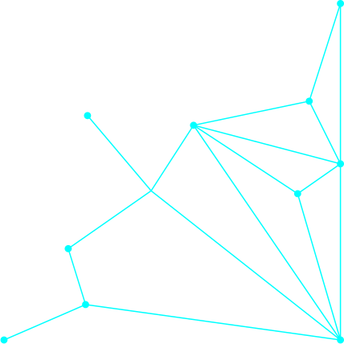
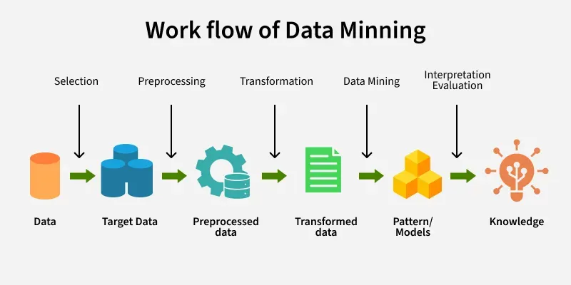
WHAT IS DATA MINING
In today’s digital age, data is a critical asset. Effective data analysis enables organizations to identify trends, improve operations, and discover new opportunities. It bridges the gap between data collection and strategic implementation.
Data mining is a part of Knowledge Discovery in Databases (KDD)
It works on large datasets stored in databases, warehouses, or cloud storage
Main goal is to find patterns that are not easily visible.
Real-Life Examples
E-commerce (Amazon/Flipkart): Product recommendations
Banking: Fraud detection and credit risk analysis

Slide 3
TYPES OF DATA
Based on Structure
Based on Data Source
Based on Attribute
(A) Structured Data:
Data stored in a fixed format (rows & columns).
Examples:
Student records (Roll No, Name, Marks)
Bank transaction table
(A) Database Data
Stored in relational databases.
Example: Tables in MySQL
(A) Nominal Data
Categorical data without order.
Example::-Gender (Male/Female)
B) Transactional Data
Data generated from daily activities.
Example: ATM transactions
(B) Ordinal Data
Categorical data with order or ranking
.
Example::-Student Grades (A, B, C)
(b)Semi-Structured Data:
Data does not follow a strict table format but still has some structure.
Examples:
XML files
JSON data
(C) Data Warehouse Data
Large historical data stored for analysis and reporting.
Example: Company sales reports over 10 years
(C) Interval Data
Numerical data where difference matters but no true zero.
Example::-Temperature in Celsius (0°C is not absence of temperature)
C) Unstructured Data
Data that has no fixed structure.
Examples:
Images
Videos
(D) Web Data
Data from websites and social media.
Example:
Website clicks
D) Ratio Data
Numerical data with a true zero.
Example::-Height, Weight

Slide 4
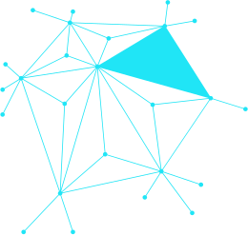
MAJOR DATA MINING FUNCTIONALITIES
1. Classification
Classification is a supervised learning technique where data is categorized into predefined classes.
Example
Email → Spam / Not Spam
Student → Pass / Fail
✔ Output is a class label.
2. Regression
Regression is used to predict a continuous numerical value.
Example
Predict house price
Predict salary
✔ Output is a number, not a category.
3. Clustering
Clustering groups similar objects into clusters without predefined labels.
(It is an unsupervised technique.)
Example
Group customers based on shopping behavior
✔ Output is a group/cluster.
4. Association Rule Mining
Association rule mining finds relationships between items that occur together frequently.
Example
In shopping:
Bread → Butter
✔ Used in Market Basket Analysis.
5. Outlier / Anomaly Detection
Outlier detection identifies data points that are very different from the normal pattern.
Example
Fraud transaction in bank
Unusual login attempt
✔ Helps in security and risk analysis.
6.Prediction
Prediction means forecasting future outcomes based on past data.
Example
Predict stock price
Predict rainfall
✔ It can be done using classification or regression models.

Slide 5
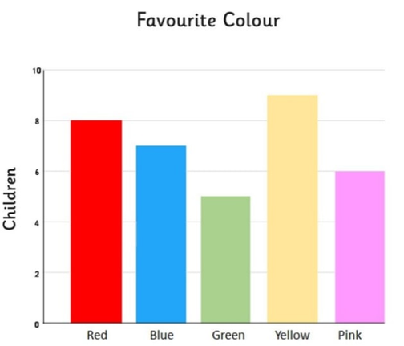
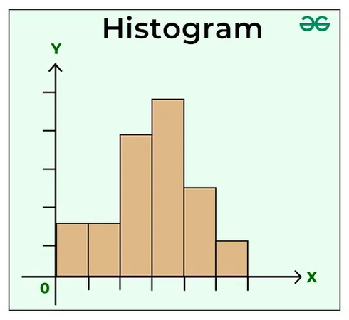
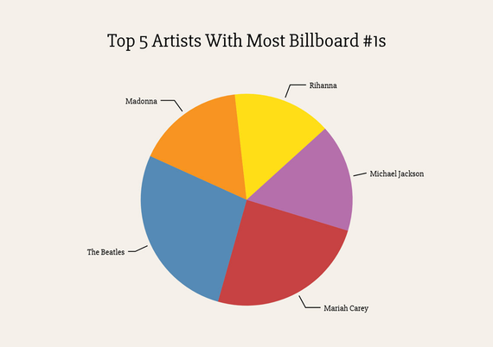
DATA VISUALIZATION
Data Visualization is the graphical representation of data using charts, graphs, and plots so that users can easily understand information and patterns.
Common Types of Data Visualization
1. Bar Chart
Used for comparing categories.
Example:-Sales of different products.
2. Pie Chart
Used to show percentage distribution.
Example:-Market share of companies.
3. Histogram
Used to show frequency distribution of numerical data.
Example:
Marks distribution of students.

Slide 6

DATA PREPROCESSING
Data Preprocessing is the process of converting raw, incomplete, and noisy data into a clean and usable format for data mining and analysis.
1. Data Cleaning
Removes errors and improves quality of data.
Handling missing values
Removing duplicates
Noise removal (incorrect data)
Correcting inconsistent values
2. Data Integration
Combines data from multiple sources into one dataset.
Merge databases/files
Remove redundant data
Resolve data conflicts
3. Data Transformation
Converts data into a suitable format for mining.
Normalization (scaling values)
Aggregation (summarizing data)
Encoding categorical values
4. Data Discretization
Converts continuous data into categories/ranges.
Example:
Age → (0–18), (19–35), (36–60)
5. Data Reduction
Reduces size of dataset while keeping important information.
Dimensionality reduction
Attribute subset selection (feature selection)
Compression and sampling

Slide 7
ATTRIBUTE SUBSET SELECTION, SAMPLING & CLUSTERING
1. Attribute Subset Selection (Feature Selection)
Attribute Subset Selection is the process of selecting the most important attributes (features) from a dataset and removing unnecessary or irrelevant ones.
Example:
For predicting student performance, useful attributes may be:
attendance
internal marks
assignment score
Unnecessary attributes may be:
student ID
phone number
2.Sampling
3. Clustering
Clustering is an unsupervised technique used to group similar data points into clusters.
Important:
No predefined labels/classes are given.
Example of Clustering
A company divides customers into:
Cluster 1: High Income, High Spending
Cluster 2: Medium Income, Medium Spending
Cluster 3: Low Income, Low Spending
This helps in better marketing strategies.
Sampling is the process of selecting a small representative subset of data from a large dataset for analysis.
Example:
Instead of analyzing 10 lakh customer records, we analyze a sample of 10,000 records.
Types of Sampling
Random Sampling
Data selected randomly
Each record has equal chance
Stratified Sampling
Data divided into groups (strata)
Samples taken from each group

Slide 8
Page 01
THANK YOU
-

